Slide 1
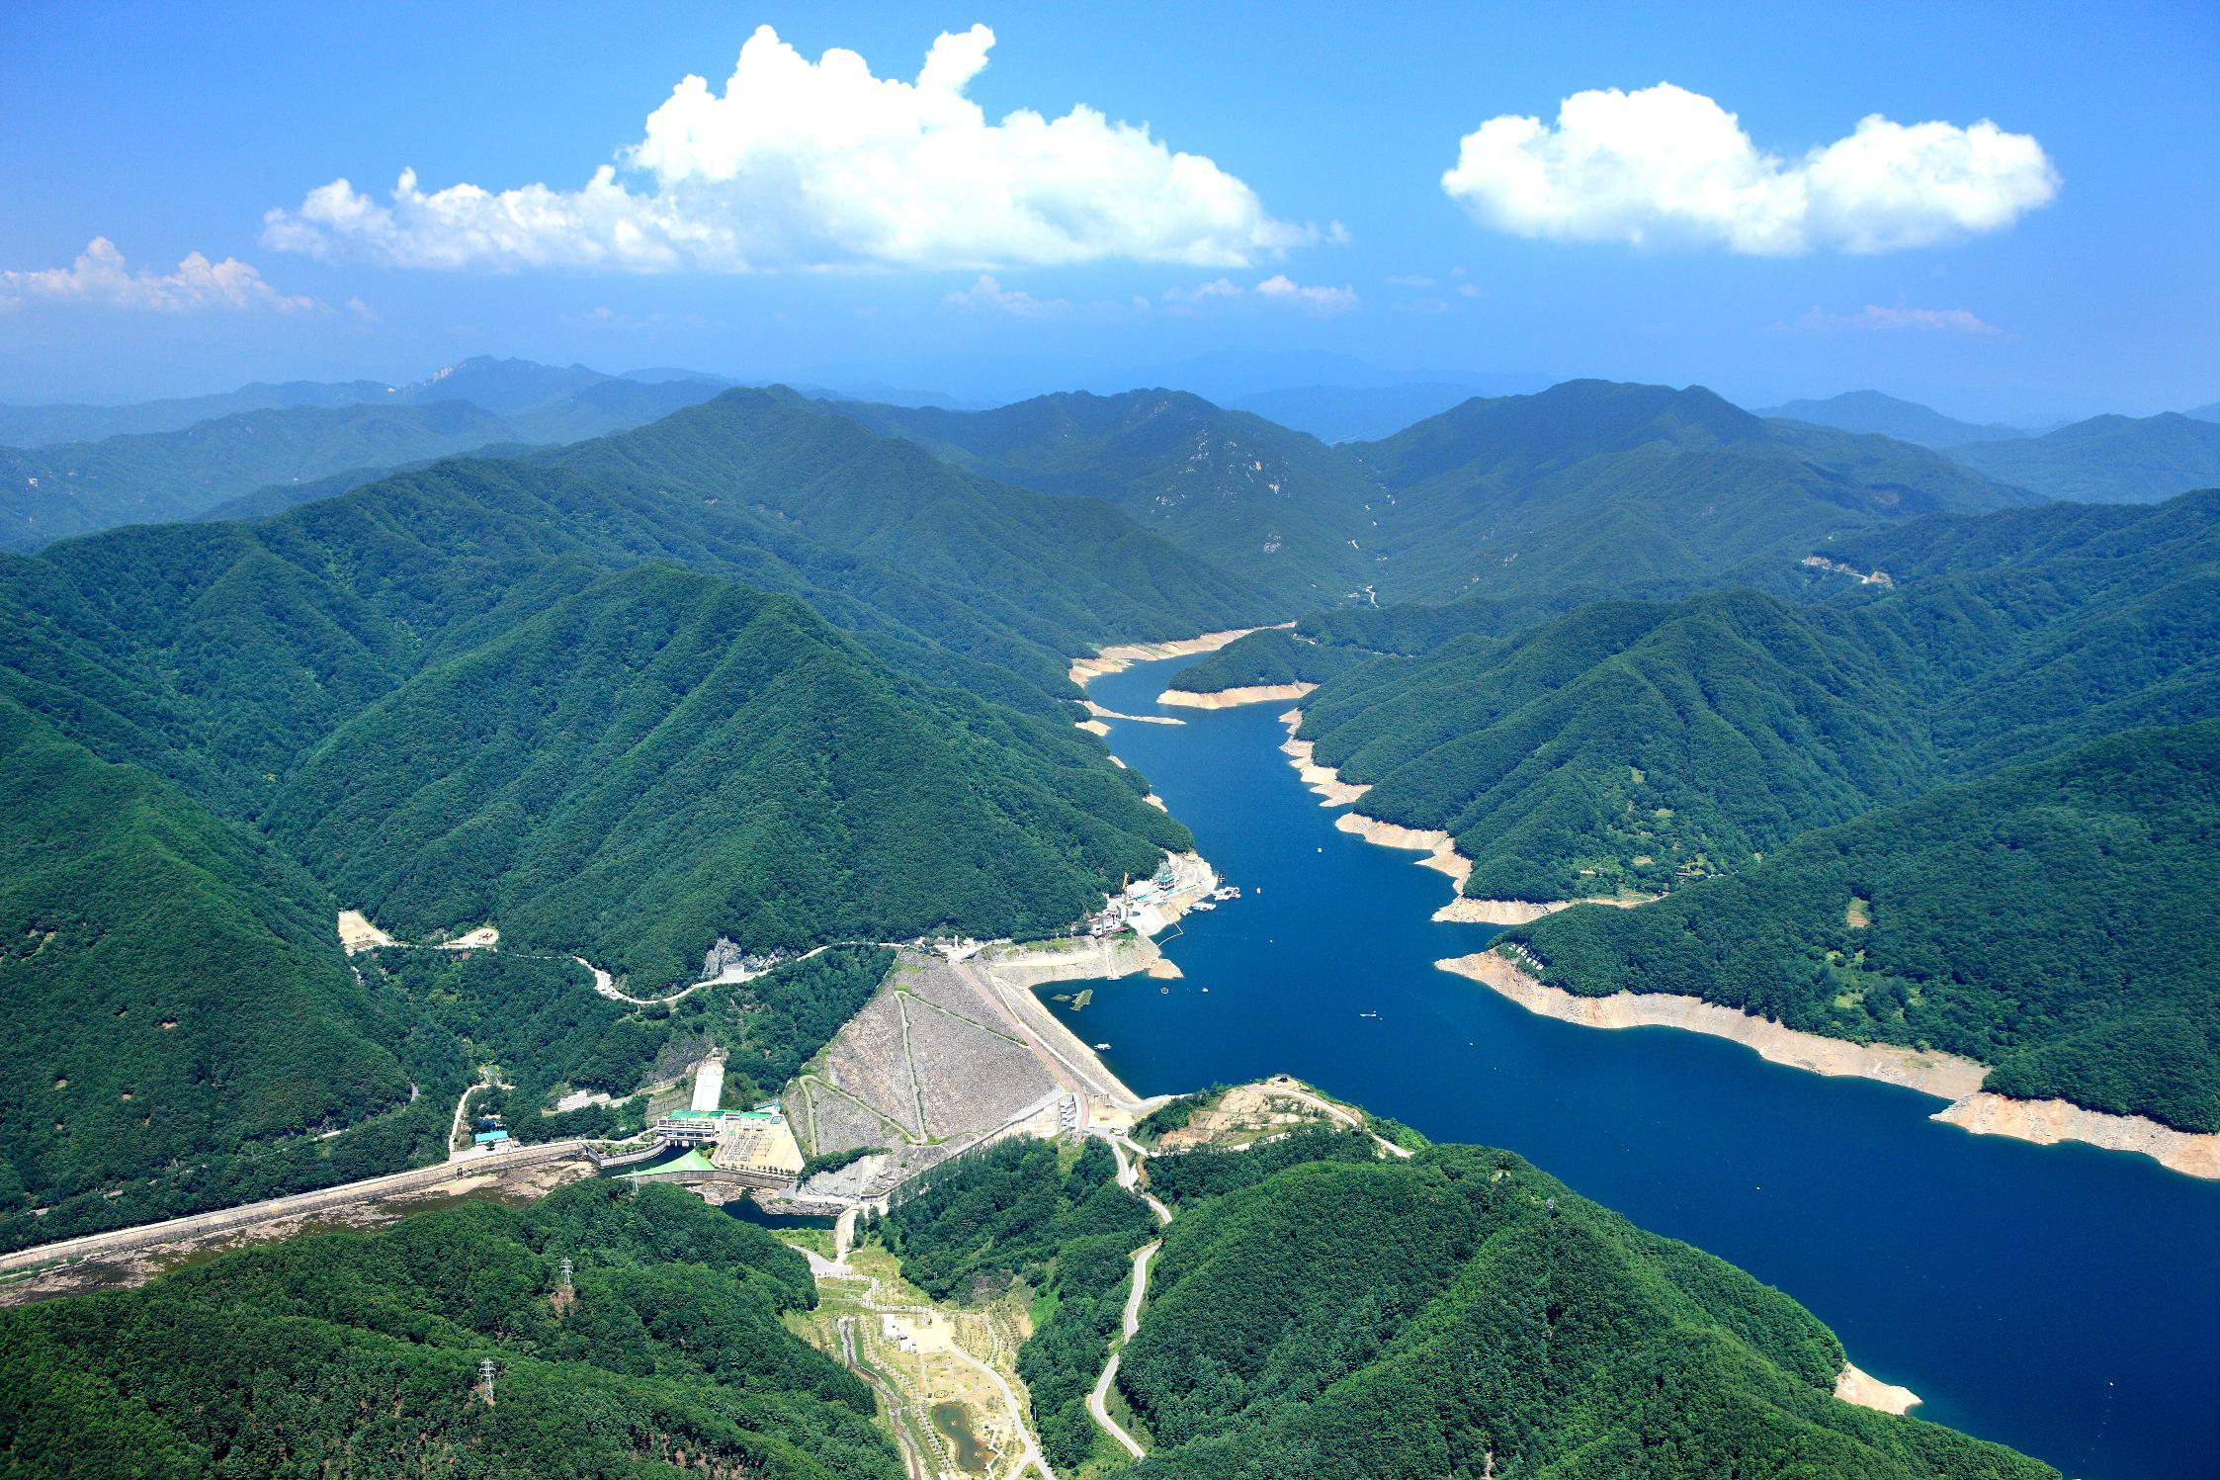


The 8th east Asian Dam conference
Welcome to Soyanggang Dam
22th Oct. 2014

Slide 2


Contents
I
General Information
Ⅱ
Climate Change Efforts

Slide 3


Ⅰ
General Information

Slide 4
1. General Information
Location
Chuncheon-si, Gangwon province, Korea
Soyanggang
Dam
History
Seoul
1967.04 : Initiated Construction
1973.10 : Completed Construction
1974.08 : Initiated O&M
Daejeon
Organization & Personnel
Busan
Director
Management Team
Construction Team
2 Teams, 50 members
Notes:
This is a Korean Peninsula. 소양강댐 is located in the Gang-won province.
The construction was started in 1967. At that time Korea was the period of industrialization.
And it was completed in 1973. it took about 6 years.
Since the completion, K-water has managed this Dam until now.
Our office has 2 teams and 50 members are working here.

Slide 5
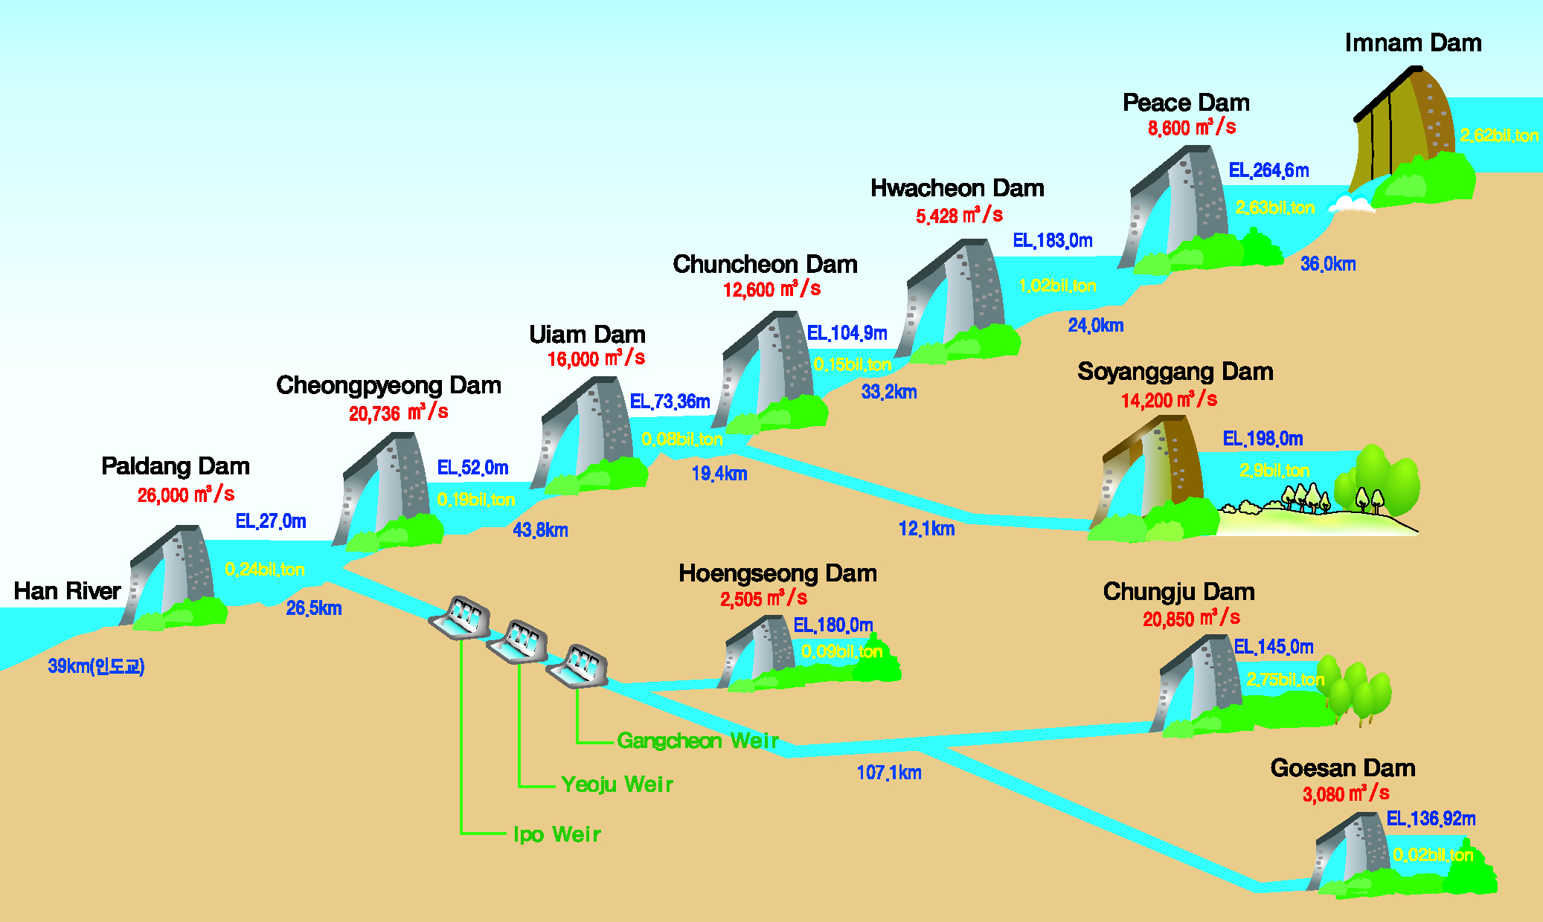
1. General Information
Diagram of Dams in the Han-river

Slide 6
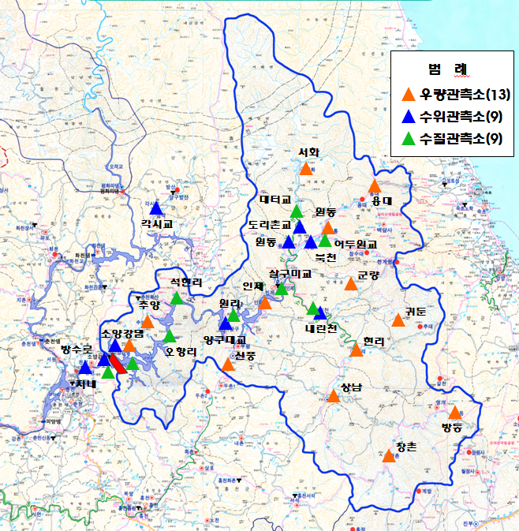

1. General Information
Roles
Flood control, water supply and electric generation
Management of Dam facilities
Water quality management
Social contribution activities
Catchment
Basin Area : 2,703㎢
Reservoir Area : 70 ㎢
Length of reservoir : 66 ㎞
Adjacent city(1) & counties(4)
(ChunCheon) & (InJe, HongCheon,
YangGu, GoSeong)
Soyanggang
Dam
Notes:
Our main roles are / flood control, water supply and electric generation by using dam.
In addition, we manage dam and subsidiary facilities as well as water quality.
And we also do various social contribution activities.
Next, let’s look at this map
The blue line means the boundary of the basin.
The area is 2,703 square kilo meters.
When the water level comes to flood water level, the reservoir area is 70 square kilo meters

Slide 7
1. General Information
Structure
Dam Type : Earth Core Rockfill Dam
Gates : B13m * H13m * 5EA
B14.7m * H14m * 4EA
Height / Length : 123m / 530m
Generator : 100,000kW * 2EA
Crest EL.203m
Flood water Lev 198.0m (2.9bil㎥)
Normal high Lev 193.5m
Flood Control Capacity
Restricted Lev during flood 190.3m
Low water Lev 150.0m
Dead water Lev 130.0m
Sand
&
Gravel
Clay
Filter
Rock
EL.80m
540m
Notes:
This picture is the cross section of 소양강댐.
The type of dam is earth core rock-fill dam.
As you see from the center, It is made of clay, filter, sand & gravel and rock.
The Dam’s height is 123m and length is 530m
And the spillway is located in left side of the dam. It has 5 gates. The width is 13m and the height is 13m.
Okay, Next, I’ll explain the water level of 소양강댐
The flood water level is this red line. The designed flood frequency is 200-year.
In this case, we can store 2.9bil ㎥ of water.
And normal high water level is 193.5m, restricted water level during flood is 190.3m

Slide 8
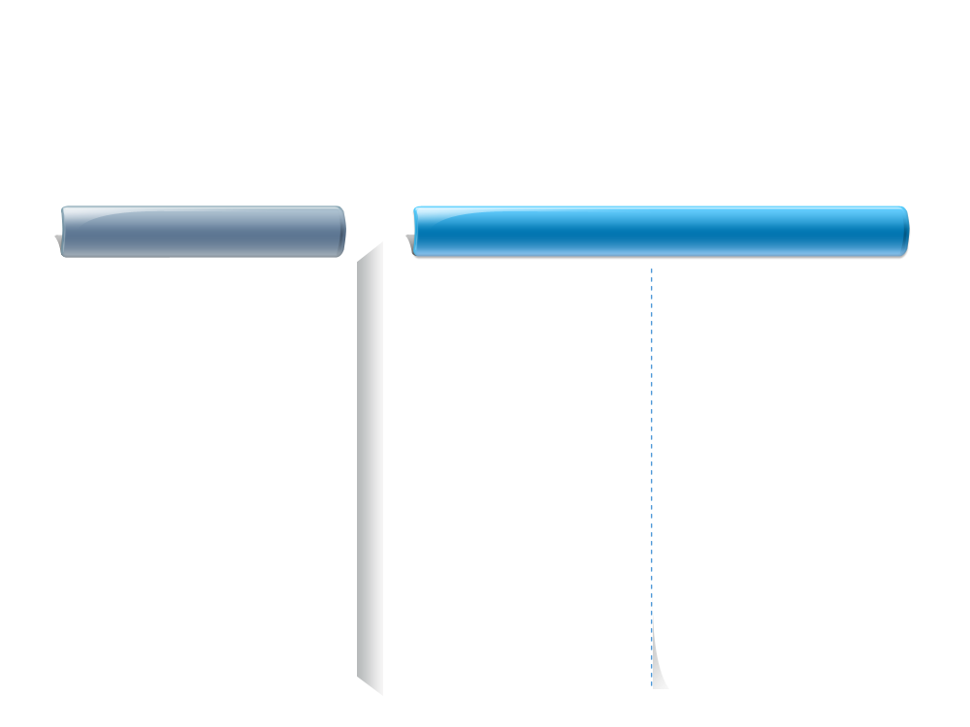
1. General Information
Benefits
Flood Control : 500 mil. tons
Flood reduction (12,620 → 5,500 ㎥/sec)
Preventing cities in downstream from flooding (i.e. : Seoul)
Water Supply : 1,213 mil. tons/yr
Supplying water to downstream areas (i.e. : Seoul & Incheon, etc.)
Preventing droughts in downstream areas
Generation : 353 GWh/yr
Can be used by 100,000 families / yr
Is equivalent to 160,000-barrel of oil consumption
Notes:
The benefit of 소양강댐 is like this.
First, we can control downstream flood.
So the downstream areas such as Seoul, 춘천 are protected safely from the flood.
Second, we can supply sufficient water to downstream
The amount is 1,213mil tons per annum
Third, we can produce clean energy without any pollution.
The amount is 353GWh/annum
It is equal to save 160,000 barrel of oil

Slide 9
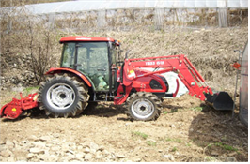
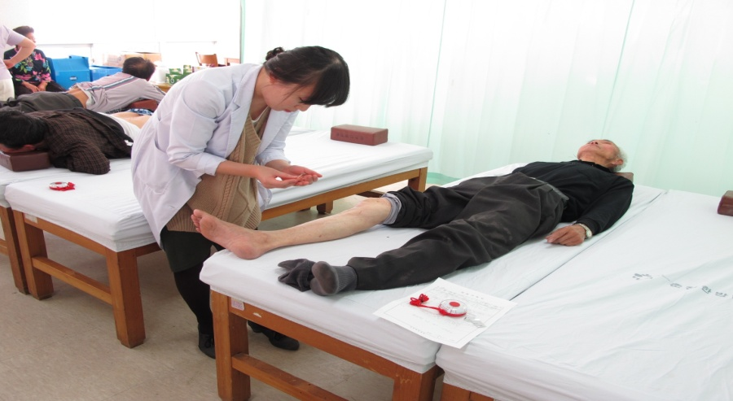

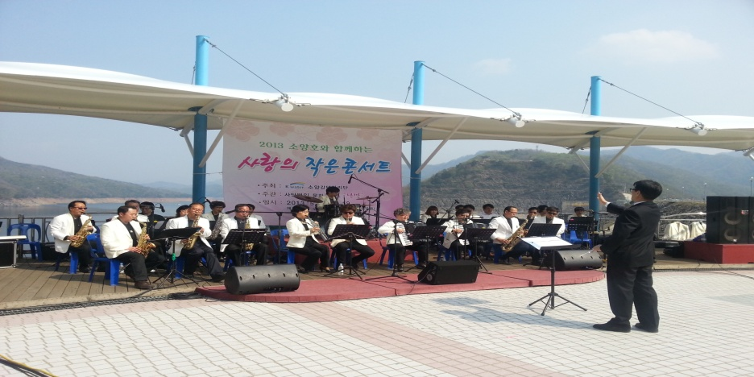
2. Providing Support to the adjacent areas
Overview
K-water supports areas around Dams through various works.
(Amount : approximately 7mil. $)
Supporting Farming machines
Promoting welfare
English village
Hosting Mini Concerts at the Dam’s Square

Slide 10
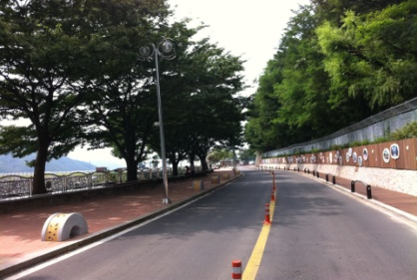
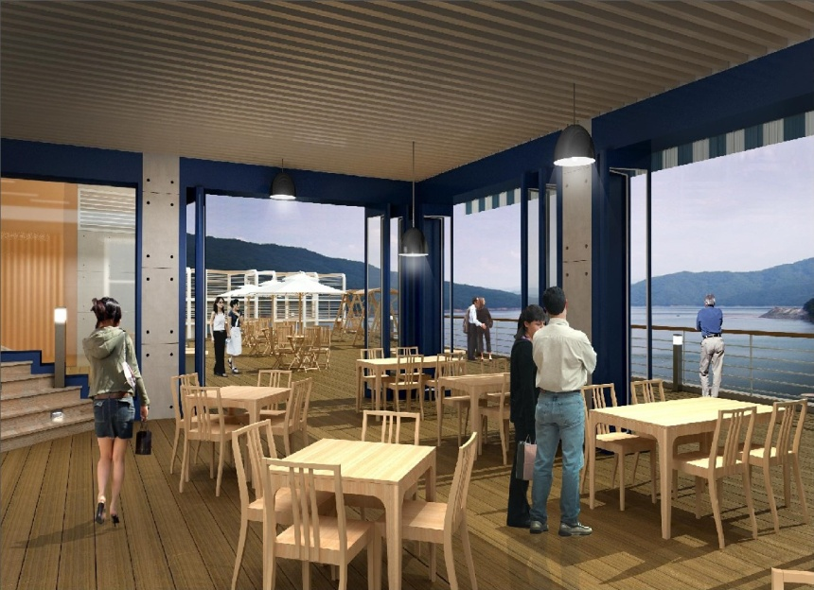
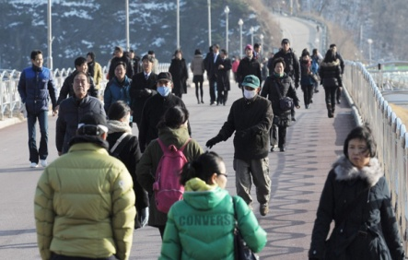
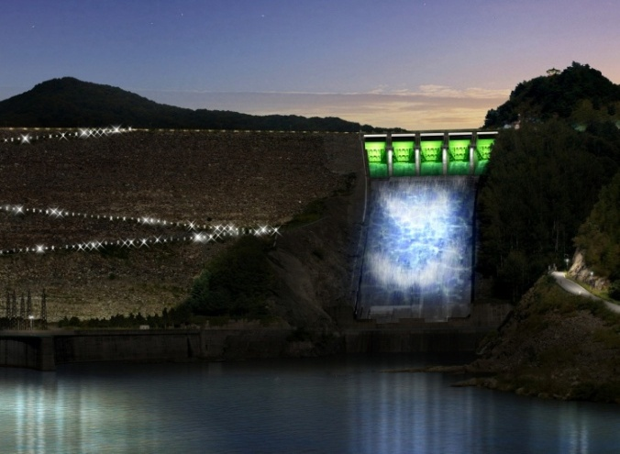
3. Plans to make the Dam more attractive
Facilities Improvement
Remodeling of exhibition hall
Opening of Dam crest road to tourists
Scenic lighting

Slide 11
Ⅱ
Climate change Efforts

Slide 12






1. The Enhancement of the Flood Control Capacity
Background
Climate changes (’84, ’90 Flood, Typhoon ‘Lusa’ etc)
Reinforcement of dam design standard (Freq. 1,000yr → PMF)
Hydrological instability (’99 Precise diagnosis of safety)
Installation of an auxiliary spillway for hydrological stability
Hydrological Factor Comparison
Rainfall (mm/2days)
Max inflow (CMS)
Max discharging (CMS)
810
20,700
14,200
632
12,400
7,500
Before
As Is
Before
As Is
Before
As Is
Notes:
First issue is “the Enhancement of the Flood Control Capacity”.
As you know, because of climate change, strong floods and rainfalls occurred more often than before.
So the design factors of dam had to be changed.
For example, PMP, PMF
So we couldn’t assure the dam’s safety.
Finally we decided to make another spillway for hydrological stability of dam.

Slide 13
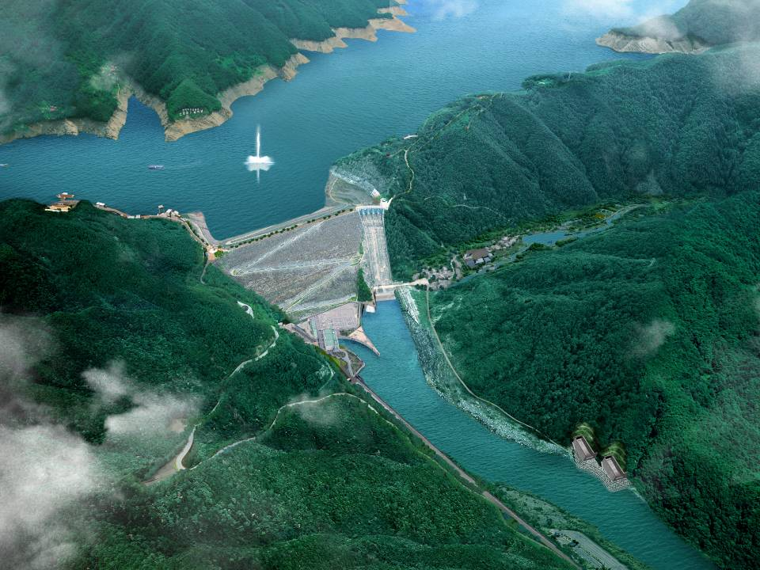
Aerial view
Inlet
observatory
Parking Lot
Exhibition hall
Ecological Park
Square park
Spillway
Access Road
Dam
Plant
❍ Structure : low-slope tunnel type spillway
❍ Tunnel size : D14m x 2ea(L1=1,276m, L2=1,206m)
❍ Max outflow : 6,700㎥/s (Spillway 7,500㎥/s)
❍ Construction period : 2004 ~ 2010
❍ Construction cost : 174.3 bil. Won ($154 mil.)
Outlet
Notes:
This is an aerial view of 소양강댐.
this is the auxiliary spillway which is low-slope tunnel type.
It consists of 2 Tunnels, and diameter is 14m. The length is about 1,200m
Max outflow of these tunnel is 6,700 tons
The construction period is from 2004 to 2010.
The cost is 154 mil. US dollars.

Slide 14
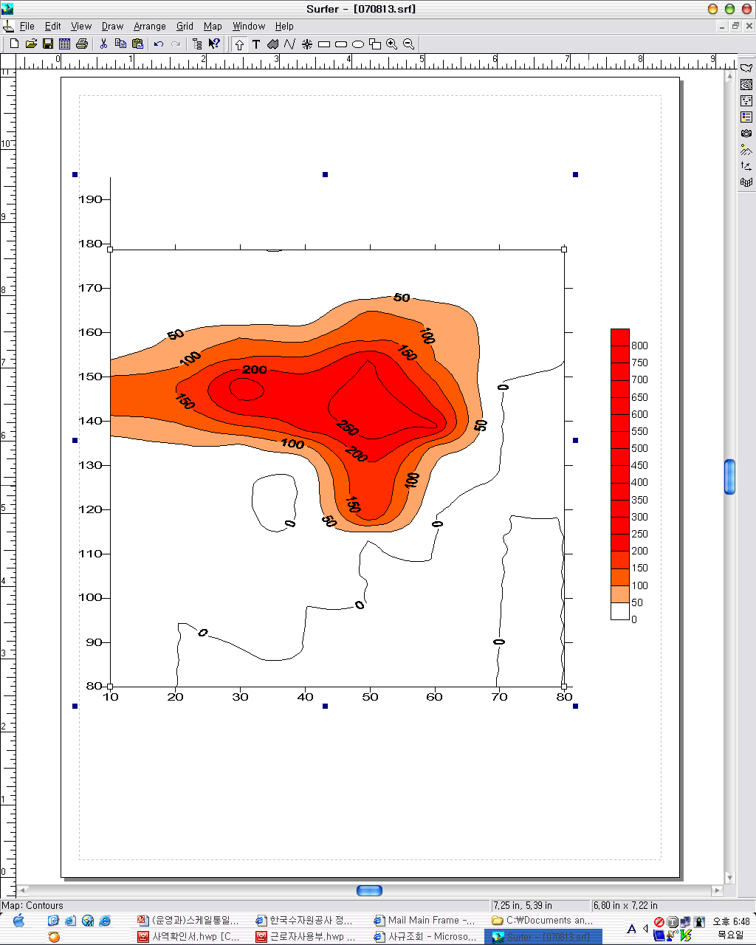
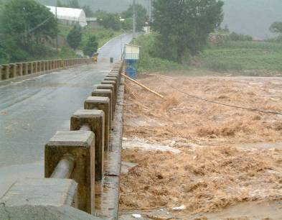

2. The facility of a Selective Intake
Status
Highly turbid water inflow after heavy rainfalls in ’06 ~ ’07
- Max turbidity : 328 NTU
- Discharging duration : 226 days(<10NTU)
’07. 8. 13
Turbid water Inflow
DAM
3km
8km
12km
18km
23km
33km
43km
Causes
Soil loss from landslide, roads and river bank loss by heavy rain
Sand and clay loss from alpine region farm
Notes:
And the second issue is the facility of a selective intake which is under construction, now.
In 2006 Summer, Highly turbid water inflowed into Soyanggang Dam after strong heavy rain.
It took about 226 days to make water quality below 10NTU.

Slide 15
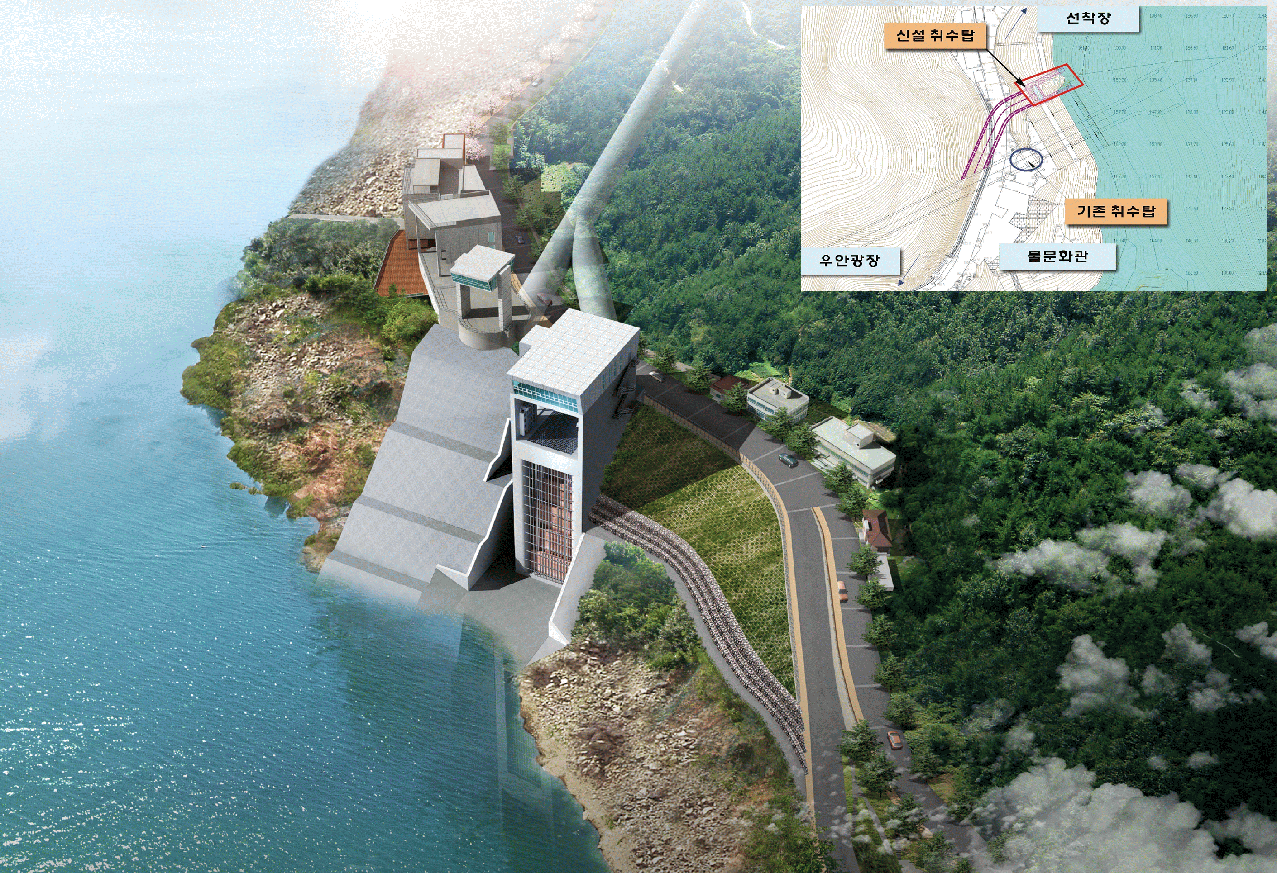
2. The facility of a Selective Intake
Bird’s eye view
New intake tower
Parking lot
Existing intake tower
Square park
Exhibition hall
❍ Tunnel type : circle(D=7.3m, L=62.0m)
❍ Building size : W16m × L22.2m × H89.2m
❍ Gate type : W10m × H14m × 3 ea
❍ Construction period : 2009.12. ~ 2015. 12.
❍ Construction cost : 47.2 bil. won ($ 44 mil.)
Notes:
This is an bird’s eye view.
Tunnel type is circular. The diameter is 7.3m and the length is 62.0m.

Slide 16

Thank You
K-water is creating a happier world with water

